Slide 1
Keyword Extraction and Technology Entity Extraction for Disruptive Technology Policy Texts
Aofei Chang
2021.9.30

Slide 2
1
Introduction and backgrounds
Contents
2
Method design and specific process
3
Results analysis and measurement
4
Conclusion and discussion

Slide 3
01
Introduction and backgrounds

Slide 4
Importance of Disruptive technology
Open up new technological tracks
Produce an overall or fundamental replacement for traditional technologies
Enhance the scientific and technological competitiveness

Slide 5
Disruptive technology texts
Specific S&T content
01
02
Projects
Industrial support
06
标题
03
Innovation mechanisms
05
04
Rewards and management
configuration

Slide 6
Purpose
Disruptive technology policies can
stimulate technological innovation and
provide corresponding support and guarantee.
Through the analysis and mining of S&T policy text, we can see the key layout, focus areas and development pulse of each country's S&T policy

Slide 7
02
Method design
&
specific process

Slide 8
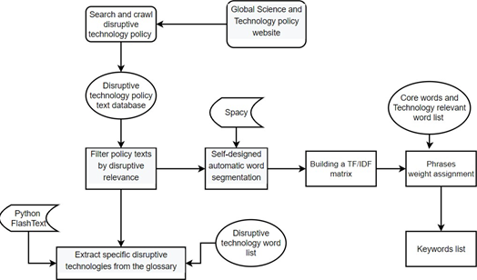
Main method flow chart
此处输入标题
请在此处输入文本，或者将文本粘贴到此处
请在此处输入文本，或者将文本粘贴到此处
此处输入标题
请在此处输入文本，或者将文本粘贴到此处
请在此处输入文本，或者将文本粘贴到此处

Slide 9
Main steps of keyword extraction
Text collection
Obtain calculation results
06
01
02
Text relevance judgement
05
03
04
weighted TF*IDF matrix
Lexicon construction
Tokenization

Slide 10
Text collection and relevance judgement
Main large websites:
The UK government website,
The EU publications website,
The US Center for Strategic and International Studies
etc.
Text collection
The content of the article is divided into three parts according to the position:
title, abstract and body
Words score formula:
Relevance judgement
Finally, 1005 English policy texts were chosen

Slide 11
Disruptive technology lexicon construction
27 core words
20 times weight
Web of Science
7400 base keywords
&
more than 300 technology-specific words
WOS integrates academic journals, invention patents, academic conferences, academic websites and various other high-quality information resources
TS = (disruptive technology OR disruptive innovation)
10 times weight

Slide 12
03
Analysis and measurement of results

Slide 13
Algorithms for comparison
YAKE
Keyword Extraction from Single Documents using Multiple Local Features
It utilizes 5 phrases characteristics: Casing, Position of Word, Word frequency, Term Relatedness to Context, Term Different Sentence
TextRank
Construct the co-occurrence graph and calculate the S-value of each node
KeyBERT
Document embeddings by using pre-trained BERT model.
Word embeddings for N-gram words/phrases.
Cosine similarity between doc and word.

Slide 14
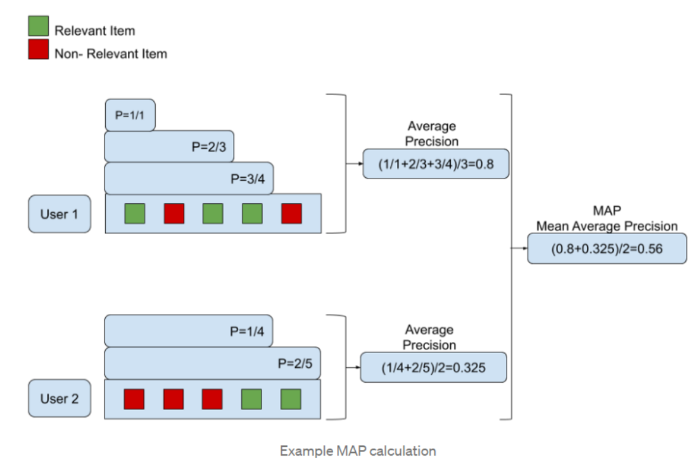
Measurement algorithms
P/R/F-Score comparison without considering keyword order
Comparison of result sequences considering keyword order.
MAP: Average Precision and Mean Average Precision

Slide 15
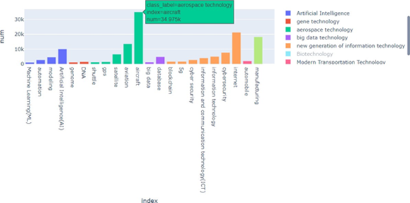
Keyword and technical entity extraction results
1.WordCloud of keywords extraction result:
2.Classification statistics of hot technical words:

Slide 16
04
Conclusion
&
discussion

Slide 17
Key findings
Artificial Intelligence
06
01
Information security
New energy
05
hotspots
Military technology
04
Internet of Things
02
03
Space technology

Slide 18
Pros and cons
Domain word lists and core words
Higher precision, recall and MAP value
Rely on deep learning algorithms for optimization
Improvement Direction
Mainly depend on a manually designed words list
Little to no ability to extract new words

Slide 19
Thanks for listening!

